Slide 1
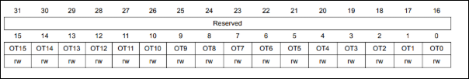
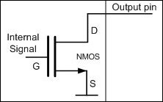
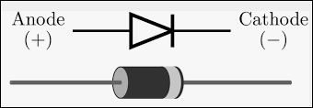
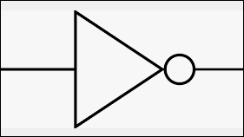


0x01
0
0
0
1

Slide 2
0x01<<1
십진수(2)
0
0
1
0

Slide 3
0x01<<2
십진수(4)
0
1
0
0

Slide 4
0x01<<3
십진수(8)
1
0
0
0

